Slide 1
Understanding Azure API Management

Slide 2
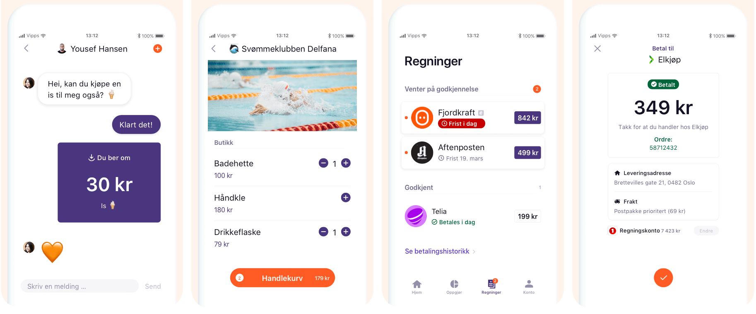
Vipps is mobile payments
Notes:
We use apim @Vipps

Slide 3



API Gateway
Client Apps
API Management
Ext. Service 4
Service 1
Service 2
Service 3

Slide 4
Essence of API Management
Façade
Hide backends from frontends
Front door
Single point of ingress
Frictionless consumption
Self-service user onboarding
Move backends without impacting frontends
Re-architect backends without impact on frontends
Expose a subset of backend capabilities
Aggregate or slice backends into APIs
Modernize legacy backends
Decouple frontend developers with mocks
Route
Authenticate
Authorize
Throttle
Transform
Trace
Meter
Discover APIs
Learn how to use APIs
Try APIs without writing any code
Request and receive access to APIs
Download API specs, samples, and SDKs
Interact with the API provider
Get usage reports
Notes:
So what are the benefits of deploying API Management in front of your services. This comes down to the essence of API Management.
APIM creates a façade in front of your service clusters
APIM serves as a front door and a single point of ingress to your backend services. It is a reverse proxy that routes incoming requests to your backend services. You can handle all of our cross-cutting concerns in API management. Since all traffic goes through APIM, Azure also collects telemetry, so you can trace requests and meter the usage.
APIM also provides kind of self-service, so we can easily onboard developers that want to use our APIs.

Slide 5
What we can do with API Management
Package and publish APIs to developers and partners
Build an API façade for existing backend services
Add new capabilities to APIs
Protect APIs from misuse and abuse
Gain insights into API usage and health
On-board developers via a self-service portal
Ramp-up developers with docs, samples, and API console

Slide 6
How do we secure our APIs?
Enforce pre-access checks.
Prevent unauthorized access
Prevent excessive usage
Watch for abnormal activity

Slide 7
Main APIM usage at Vipps
Compose APIs
Coarse grained access control
Rate limiting
Notes:
We think APIM to be a very powerful and flexible tool with lots of great features.
The most important job of APIM in Vipps is for composing APIs across services running in AKS, serverless or elsewhere.
Another use is coarse grained access control. There is no need to allow traffic further into our systems if it can be stopped at the edge, but applications are ultimately responsible for their own access control.
We also use it for rate limiting, helping protect the rest of our infrastructure and increasing overall reliability.

Slide 8
Model

Slide 9



Products and APIs
Users
Products
APIs
Azure API Management
subscribes
Vipps Services
contains subset of
Service API
Vipps App
Service API
Service API
Service API
Service API
Service API
Service API
subscribes
Merchant Services
contains subset of
Merchants
Service API
Endpoint 1
Endpoint 2

Slide 10
CD/CD

Slide 11
One deployment of all APIs
Pros
One Repository for all APIs
One CI/CD Pipeline
APIM == Codebase
API Management
APIM Repo
API W
API W
API X
API X
All APIs
Cons
Time consuming
Expensive process
High risk?
API Y
API Y
API Z
API Z

Slide 12
Re-structuring APIs
Application W
API W
Application W
API W
Application X
API X
Application X
API X
Application Y
Application Y
API Y
API YZ
Application Z
Application Z
API Z
Managed by specialized teams
Managed by product teams

Slide 13
De-coupled API deployment
Pros
Lower risk
Faster deployment
API Management
APIM Repo
API W
API W
API X
API X
Cons
2 Swagger files (APIM Repo + Application Repo)
APIs in separate repository
API Y
API Y
API Z
API Z

Slide 14
API artifacts inside application repositories
Pros
Great for autonomous teams
Flexible
API Management
APIs inside application repos
Application W
API W
API W
Repo W
Application X
API X
API X
Repo X
Cons
Harder to keep under control
More complicated CI/CD setup
Repo Y
Application Y
API Y
API Y
Repo Z
Application Z
API Z
API Z

Slide 15
Deployments

Slide 16
APIM repository
+ apim
+ apis
+ payments
payments-arm.json
payments.policy.xml
payments.swagger.json
+ invoice
+ operation-policies
get-invoice.policy.xml
create-invoice.policy.xml
invoice-arm.json
invoice.policy.xml
invoice.swagger.json

Slide 17
APIM repository
Payments service repository
+ apim
+ apis
+ payments
payments-arm.json
payments.policy.xml
payments.swagger.json
+ invoice
+ operation-policies
get-invoice.policy.xml
create-invoice.policy.xml
invoice-arm.json
invoice.policy.xml
invoice.swagger.json
+ deploy
+ apim
+ apis
+ payments
payments-arm.json
payments.policy.xml
payments.swagger.json
Invoice service repository
+ deploy
+ apim
+ apis
+ invoice
+ operation-policies
get-invoice.policy.xml
create-invoice.policy.xml
invoice-arm.json
invoice.policy.xml
invoice.swagger.json

Slide 18

APIM repository
Payments service repository
+ apim
+ apis
+ payments
payments-arm.json
payments.policy.xml
payments.swagger.json
+ invoice
+ operation-policies
get-invoice.policy.xml
create-invoice.policy.xml
invoice-arm.json
invoice.policy.xml
invoice.swagger.json
+ deploy
+ apim
+ apis
+ payments
payments-arm.json
payments.policy.xml
payments.swagger.json
Invoice service repository
+ deploy
+ apim
+ apis
+ invoice
+ operation-policies
get-invoice.policy.xml
create-invoice.policy.xml
invoice-arm.json
invoice.policy.xml
invoice.swagger.json

Slide 19
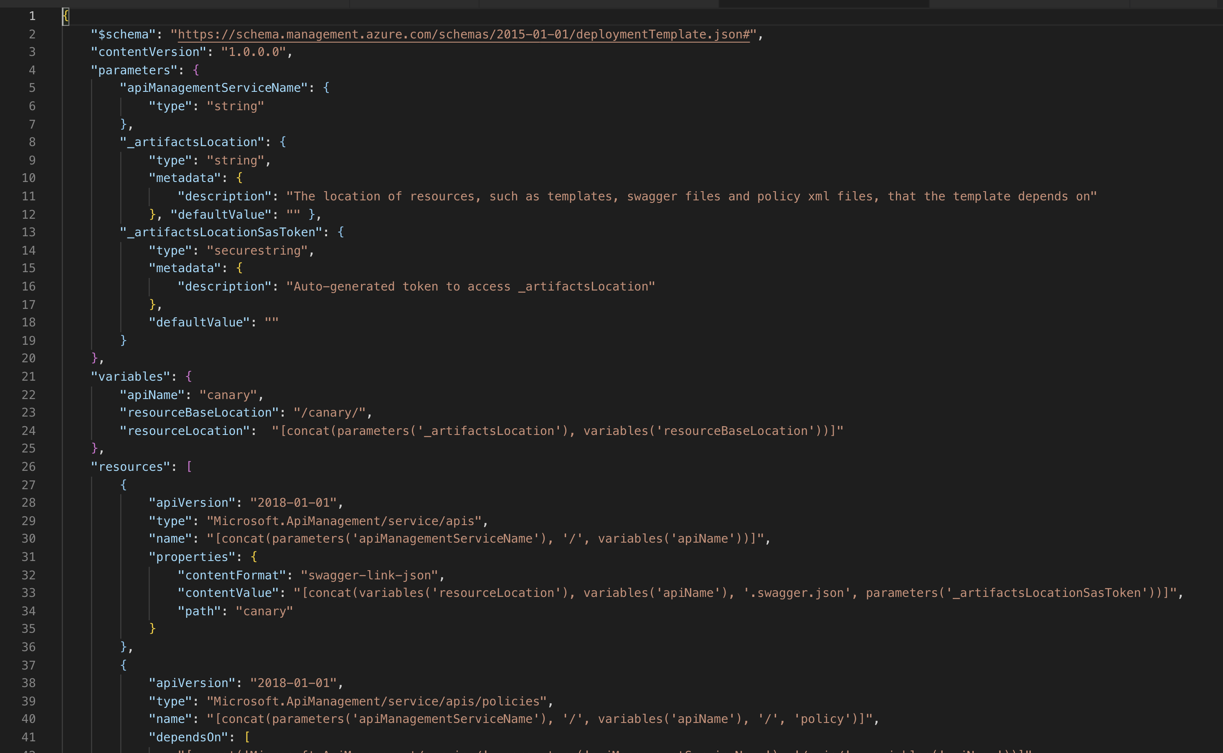
Notes:
Developers are not familiar with ARM schema

Slide 20
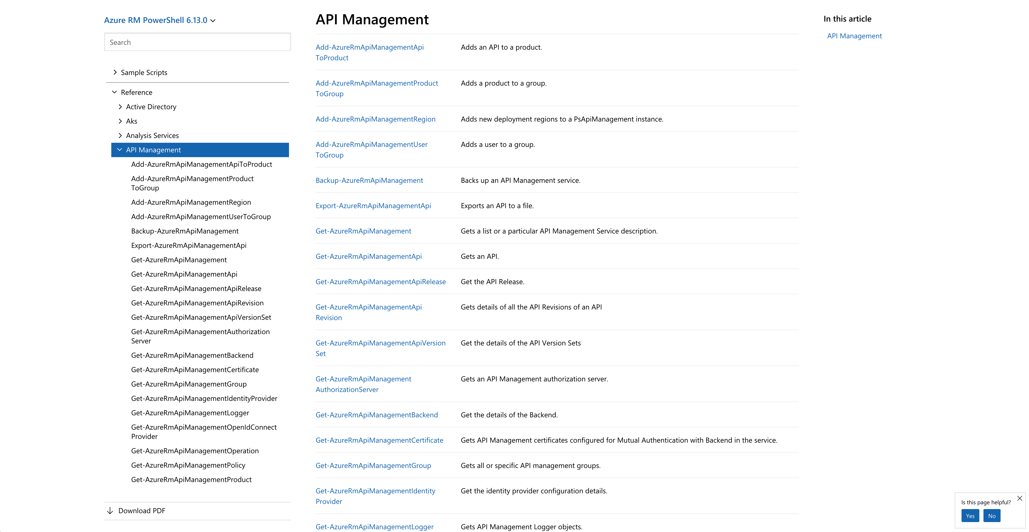
PowerShell module
Notes:
AzureRm

Slide 21
>

Slide 22
> $apimContext = New-AzApiManagementContext -ResourceGroupName "VIPPS-SIT-rg" -ServiceName "VIPPSSITapi02"
>

Slide 23
> Import-AzApiManagementApi -Context $apimContext -SpecificationFormat "Swagger" -SpecificationPath "/Users/sma/git/msbuild/files/2.20-swagger-canary.json" -Path "canary" -ApiId "canary"
ApiId : canary​
Name : Canary​
Description : This is the canary app. Its purpose is just to sit on a server and look pretty.​
ServiceUrl : ​
Path : canary​
ApiType : http​
Protocols : {Https}​
AuthorizationServerId : ​
AuthorizationScope : ​
SubscriptionKeyHeaderName : Ocp-Apim-Subscription-Key​
SubscriptionKeyQueryParamName : subscription-key​
ApiRevision : 1​
ApiVersion : ​
IsCurrent : True​
IsOnline : False​
Id : /subscriptions/123456-1234-1234-1234-12345678/resourceGroups/VIPPS-BUILD-rg/providers/Microsoft.ApiManagement/service/VIPPSBUILDapi02/apis/canary​
ResourceGroupName : VIPPS-BUILD-rg​
ServiceName : VIPPSBUILDapi02​
​
​

Slide 24
>

Slide 25
> Get-AzApiManagementApi -Context $apimContext -ApiId "canary"
ApiId : canary​
Name : Canary​
Description : This is the canary app. Its purpose is just to sit on a server and look pretty.​
ServiceUrl : ​
Path : canary​
ApiType : http​
Protocols : {Https}​
AuthorizationServerId : ​
AuthorizationScope : ​
SubscriptionKeyHeaderName : Ocp-Apim-Subscription-Key​
SubscriptionKeyQueryParamName : subscription-key​
ApiRevision : 1​
ApiVersion : ​
IsCurrent : True​
IsOnline : False​
Id : /subscriptions/123456-1234-1234-1234-12345678/resourceGroups/VIPPS-BUILD-rg/providers/Microsoft.ApiManagement/service/VIPPSBUILDapi02/apis/canary​
ResourceGroupName : VIPPS-BUILD-rg​
ServiceName : VIPPSBUILDapi02​
​
​

Slide 26
>

Slide 27
> Set-AzApiManagementPolicy -Context $apimContext -ApiId "canary -PolicyFilePath "/Users/sma/git/msbuild/files/2.20-canary.policy"
>

Slide 28
Architecture

Slide 29
Virtual Network
Virtual Network
API Management
Azure Kubernetes Service (AKS)
Pod
API X
Service A type: ClusterIP
Pod
Ingress Controller
mTLS
Pod
API Y
Service B
type: ClusterIP
Pod
Abstraction layer in front of pods and a reliable way for accessing pods because Pods can run anywhere in the cluster.

Slide 30
Virtual Network
API Management
Azure Kubernetes Service (AKS)
Pod
API X
Service A
type: LoadBalancer
Pod
Pod
API Y
Service B
type: LoadBalancer
Pod
We might want to keep our cluster completely private.
Notes:
i.e. provisioning envs for teams

Slide 31

API Management
Azure Functions
API X
Function App Y
Order
Order
GET
GET
POST
POST
Product
Product
GET
GET
Function App Z
Inventory
Inventory
GET
GET

Slide 32
Let’s do some work ...

Slide 33
Policies.

Slide 34
Changing the behavior of an API
APIM Policy
Header validation
Mocking
Rate limiting
Monetizing websites
Client
Inbound
Backend
Service
Outbound
OnError
Notes:
Showing policy templating

Slide 35
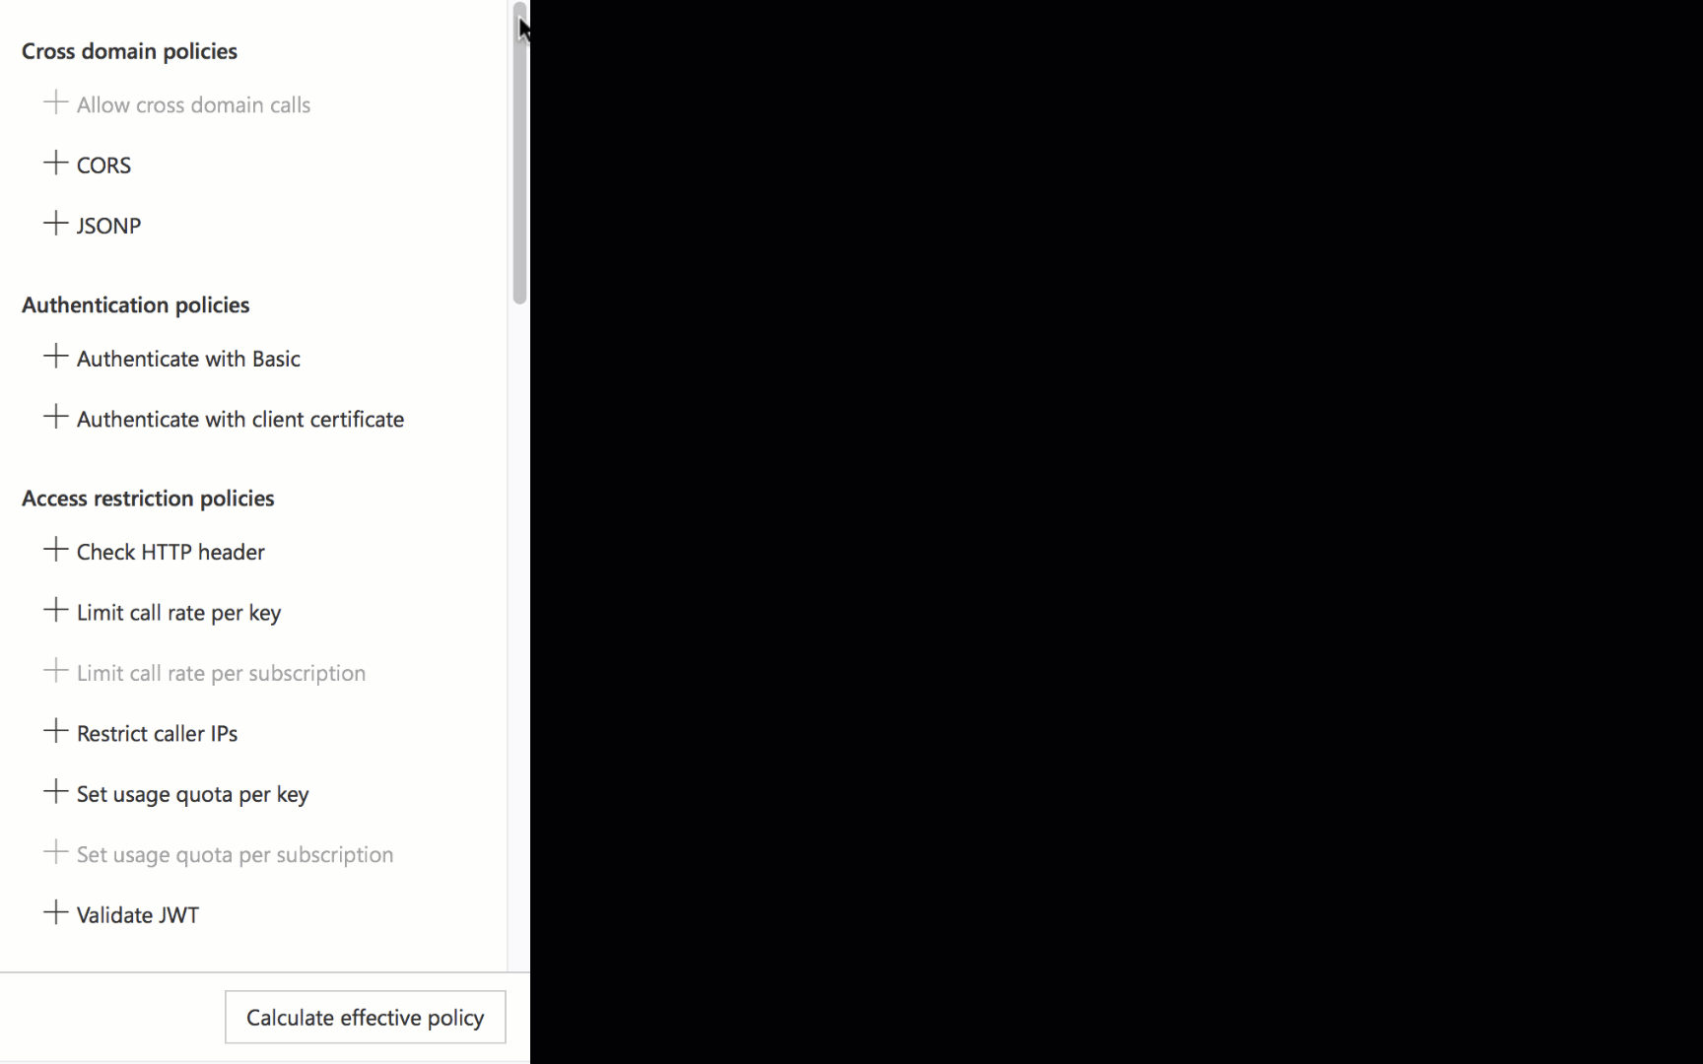
There is a policy for that
Encapsulate common API management functions
Access control, Protection, Transformation, Caching, …
Mutate request context or change API behavior
Set in the inbound and outbound directions
Can be triggered on error
Applied at a variety of scopes

Slide 36
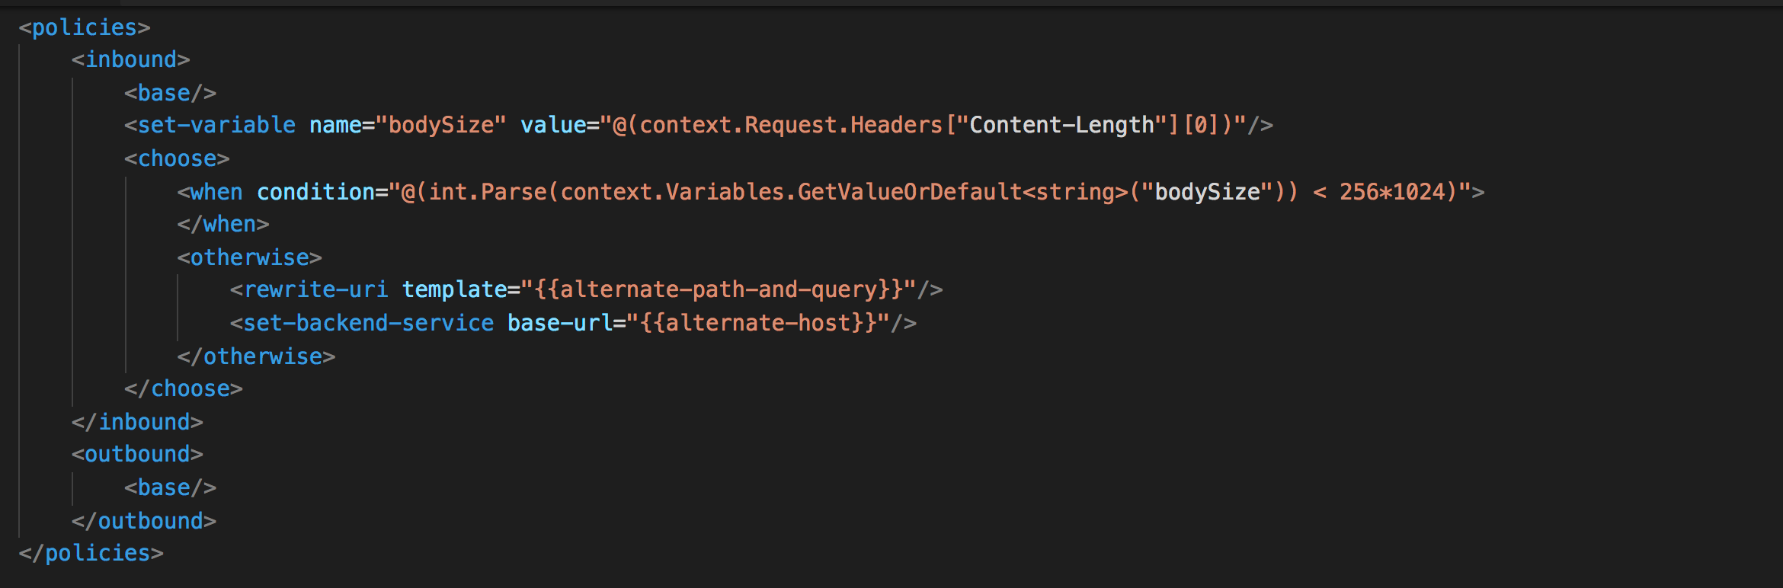
Policy expressions
Named values
C# “snippets” used with policies
Read-only access to the request context
Can use whitelisted .NET types
Dynamically configure and conditionally execute policies
Shared across APIM instance
Keep secrets and “magic” strings out of policies
Add semantics, if named well
Enable a single point of change
Provide environment-specific values

Slide 37
Basic API policy
<policies>
<inbound>
<base />
<set-backend-service base-url="{{AKSBackendUrl}}/payments/" />
</inbound>
<backend>
<base />
</backend>
<outbound>
<base />
</outbound>
</policies>

Slide 38
Mock template to include
<choose>
<when condition="@({{${isServiceDown}}})">
<return-response>
<set-status code="400" reason="Bad Request" />
<set-header name="Content-Type" exists-action="override">
<value>application/json;charset=UTF-8</value>
</set-header>
<set-body>{"kind": "unsupported"}</set-body>
</return-response>
</when>
</choose>

Slide 39
API Policy template
<policies>
<inbound>
<base />
<tal metal:use-macro='load:_mock.policy.xml'
tal:define="isServiceDown 'isPaymentsDown'" />
<set-backend-service base-url="{{AKSBackendUrl}}/Payments/" />
</inbound>
<backend>
<base />
</backend>
<outbound>
<base />
</outbound>
</policies>

Slide 40
To learn more about API Management
Tutorials, documentation, and references | http://aka.ms/apimdocs
Questions and discussions | http://aka.ms/apimso
Reusable policy examples | http://aka.ms/apimpolicyexamples
DevOps guidance and tools | http://aka.ms/apimdevops

Slide 41
Let’s do some work again ...

